Slide 1

Learn• Educate• Collaborate

Slide 2
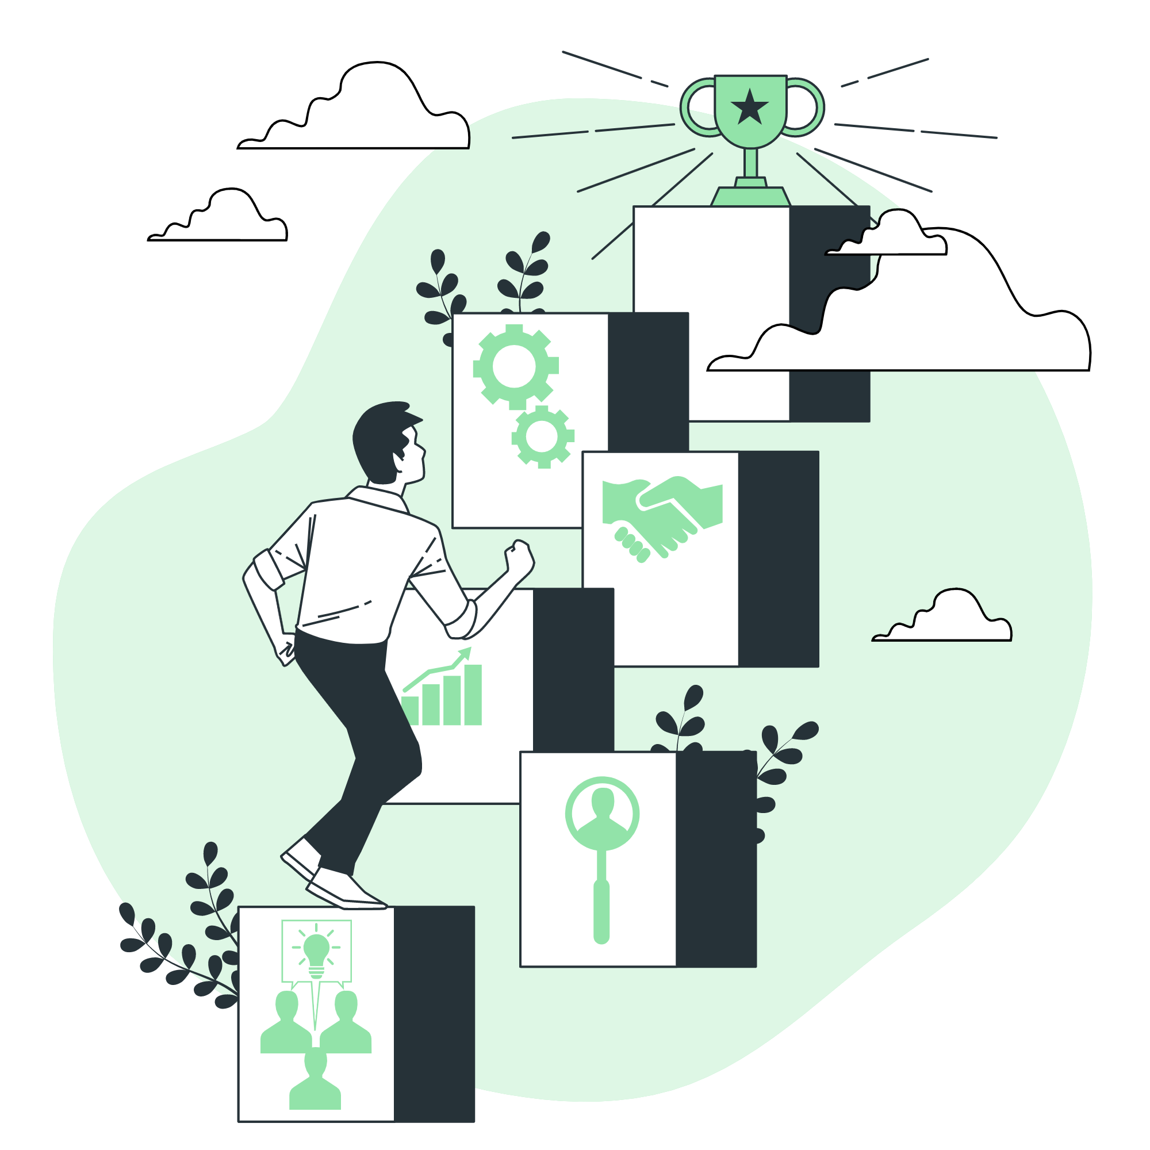
Who are we?
A group of AI enthusiasts from GEC Thrissur
What are our motives?
To cultivate an AI culture
To form an enthusiastic AI community
To facilitate students to learn, educate and collaborate on AI.

Slide 3
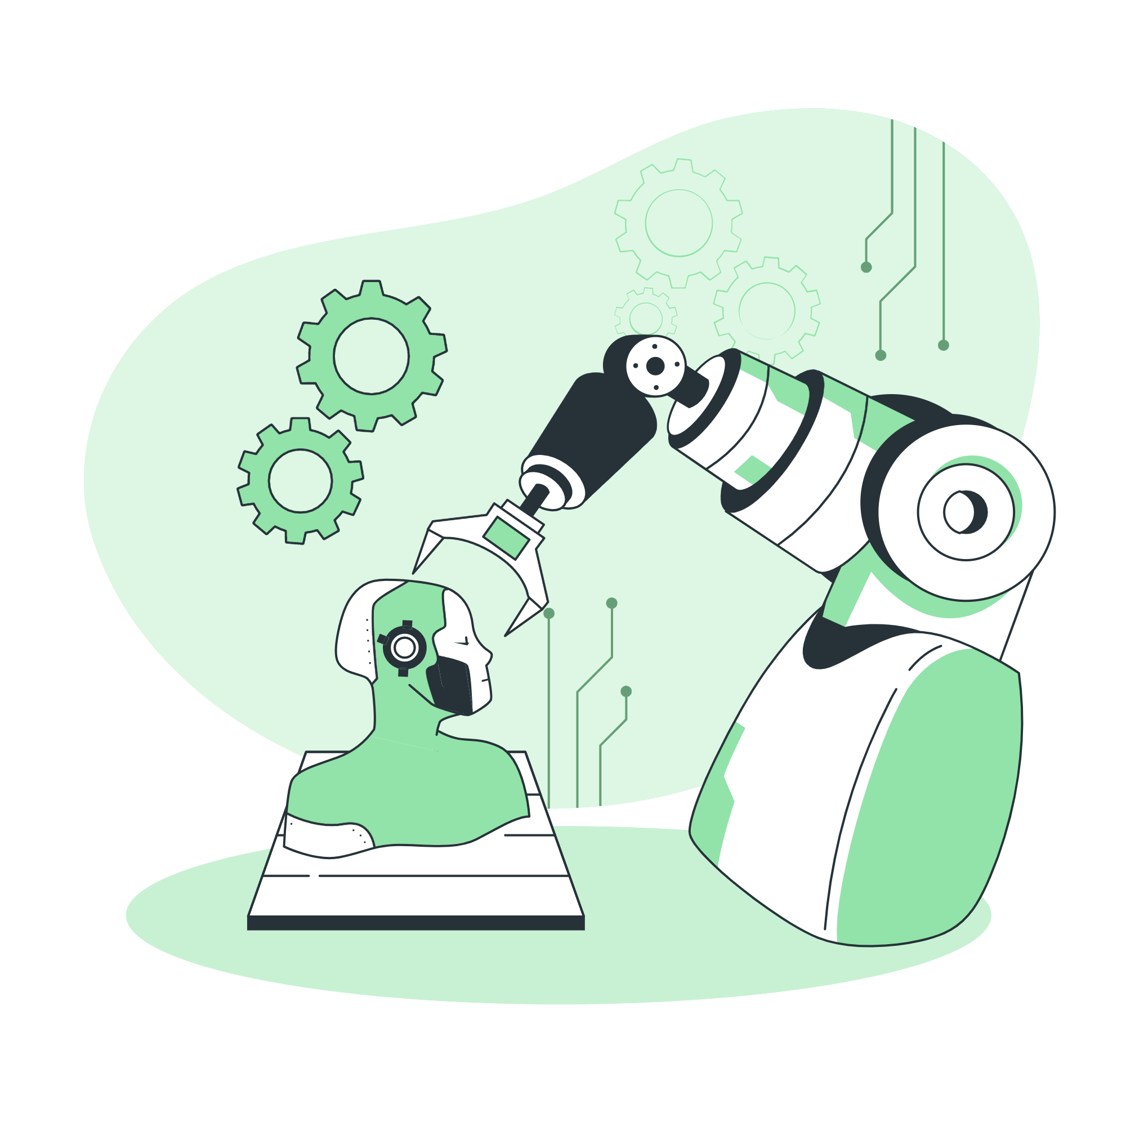
Robotics
& AI

Slide 4
What do you know about Robotics?

Slide 5
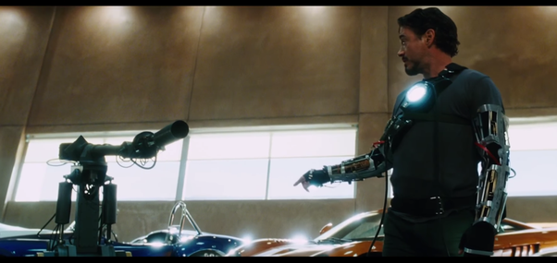
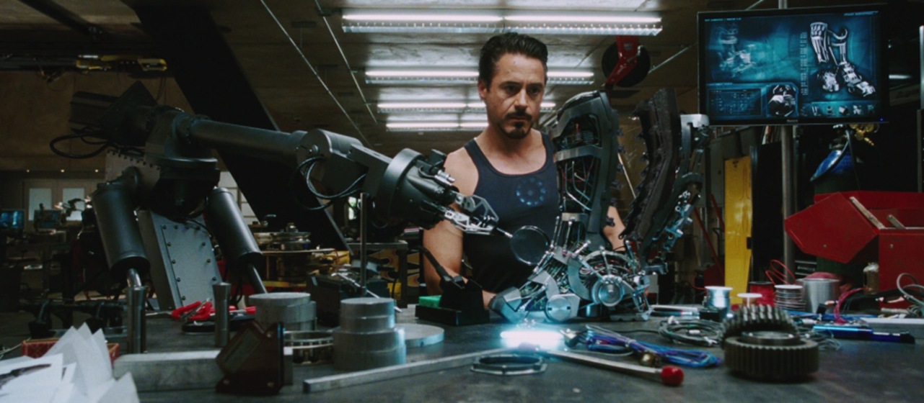

Slide 6
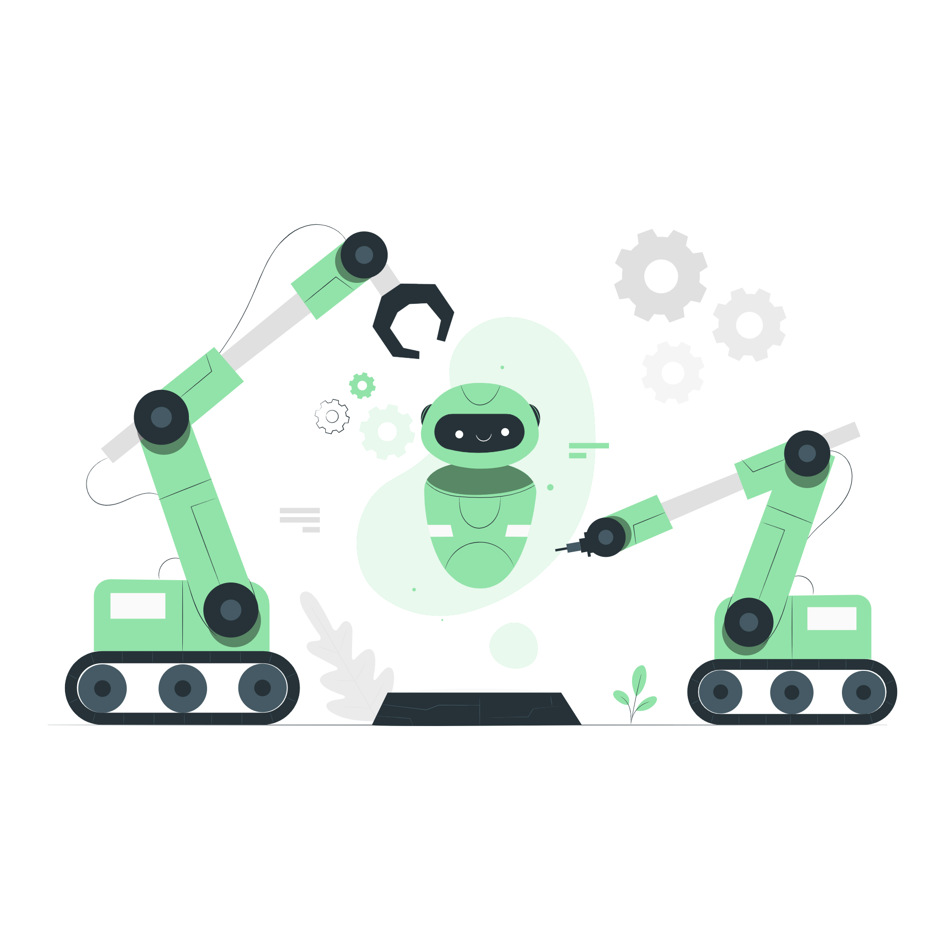
Robotic Arm(Manipulator)

Slide 7
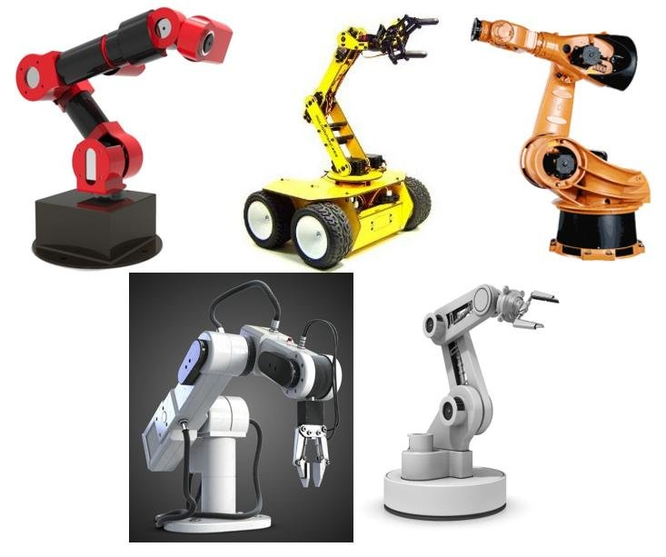
Manipulators
In robotics, a manipulator is a device used to manipulate materials without direct physical contact by the operator.

Slide 8
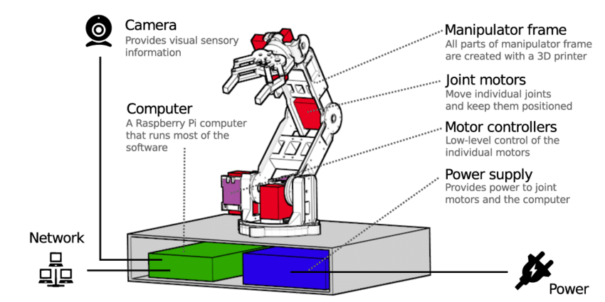

Slide 9
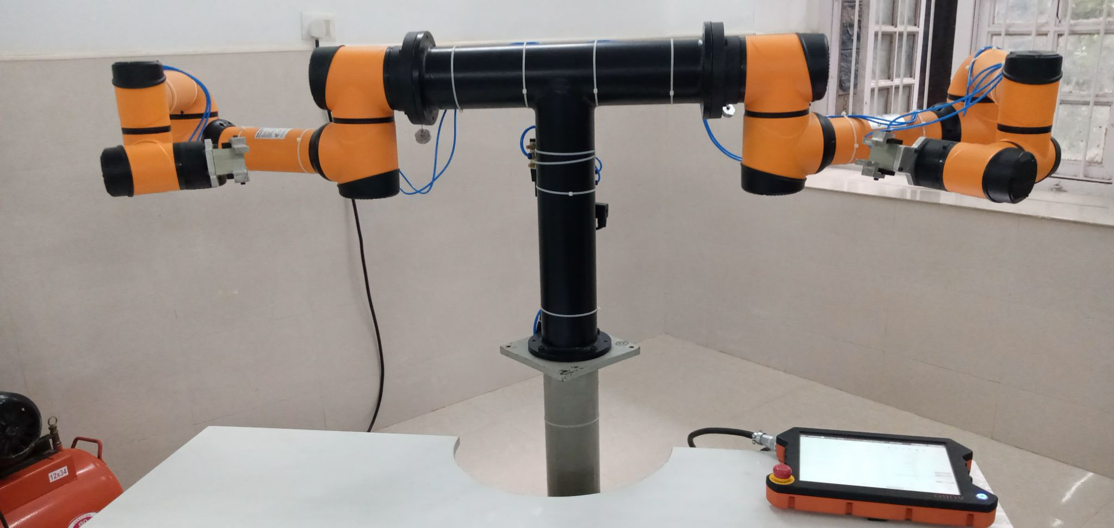
Aubo i5

Slide 10
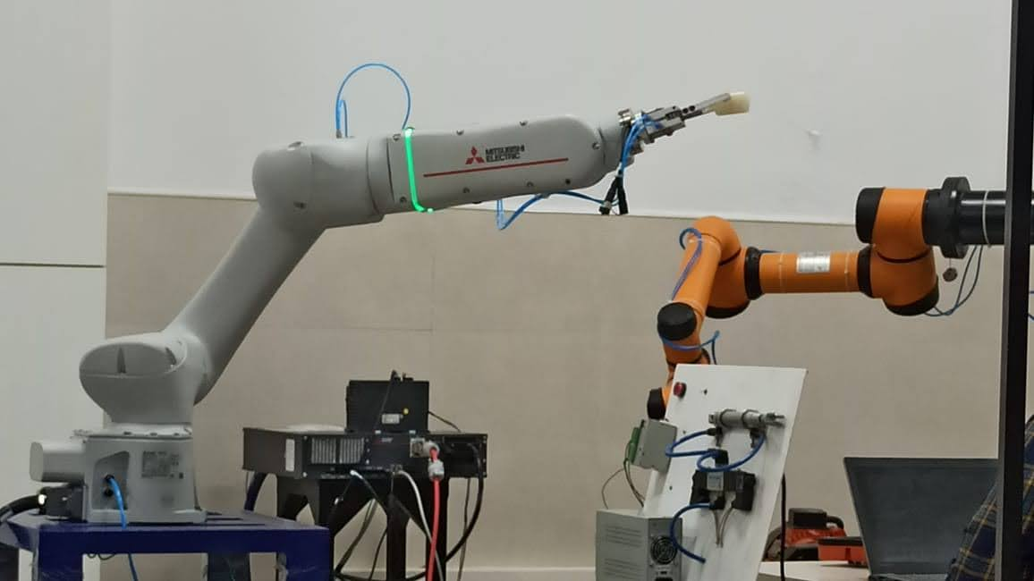
Mitsubishi CoBot

Slide 11
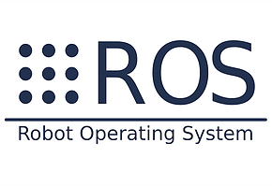
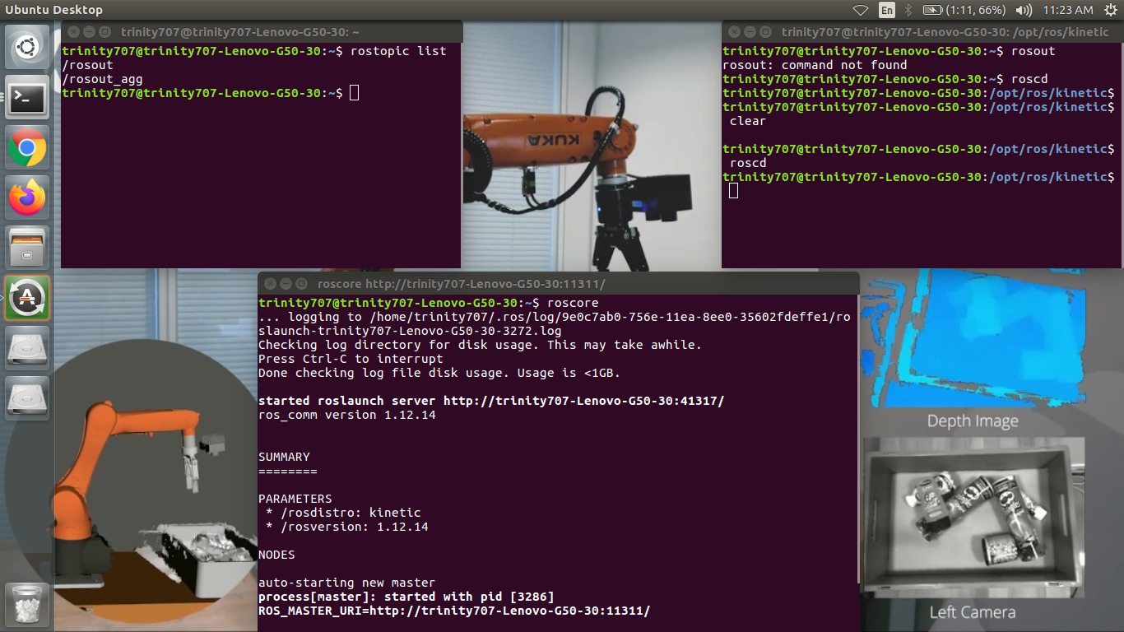
ROS
The Robot Operating System (ROS) is a set of software libraries and tools that help you build robot applications. From drivers to state-of-the-art algorithms, and with The Robot Operating System (ROS) is a set of software libraries and tools that help you build robot applications. From drivers to state-of-the-art algorithms, and with powerful developer tools, ROS has what you need for your next robotics project. And it's all open source.powerful developer tools, ROS has what you need for your next robotics project. And it's all open source.

Slide 12
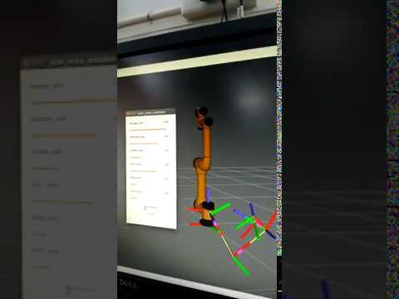
Simulations
Rviz(visualization Tool)
Gazebo(simulation Tool)
CAD models

Slide 13
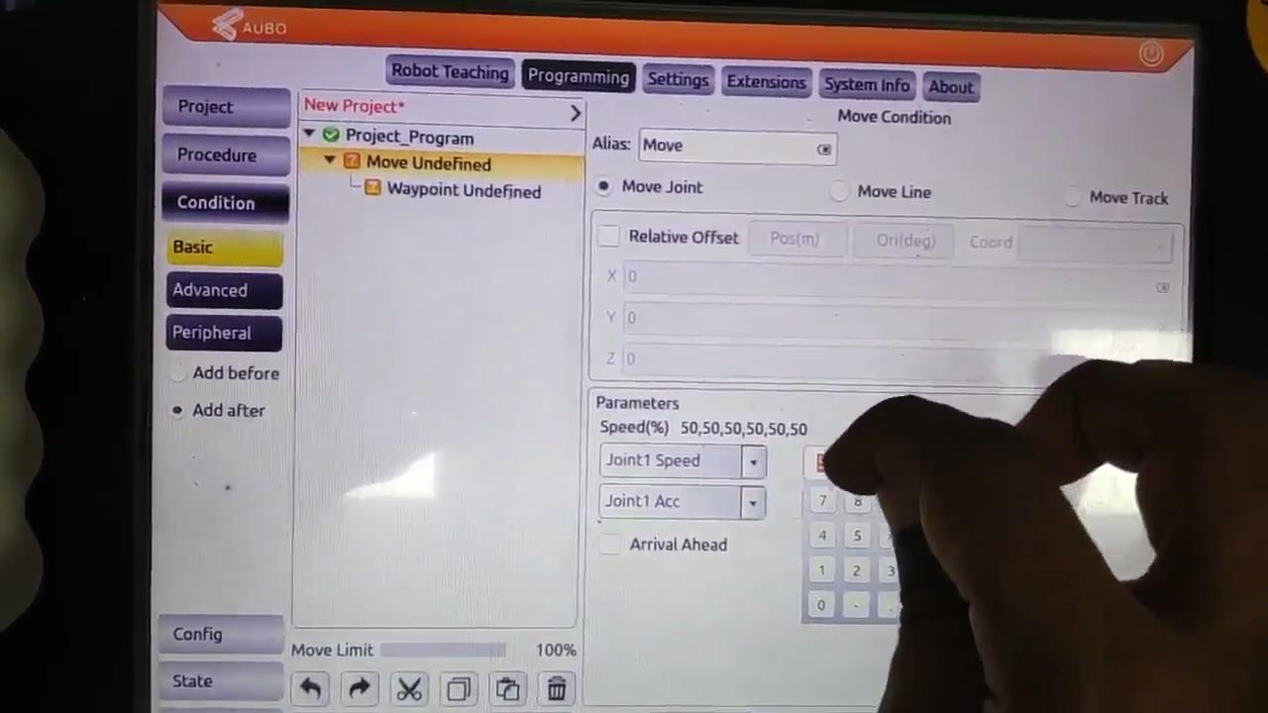
Teach Pentant

Slide 14
Applicatons
A
C
Pick and place
A moving object
Dual arm Coordination
A
B
B
D
Welding/cutting/drilling etc
And Many more……...
C
D

Slide 15
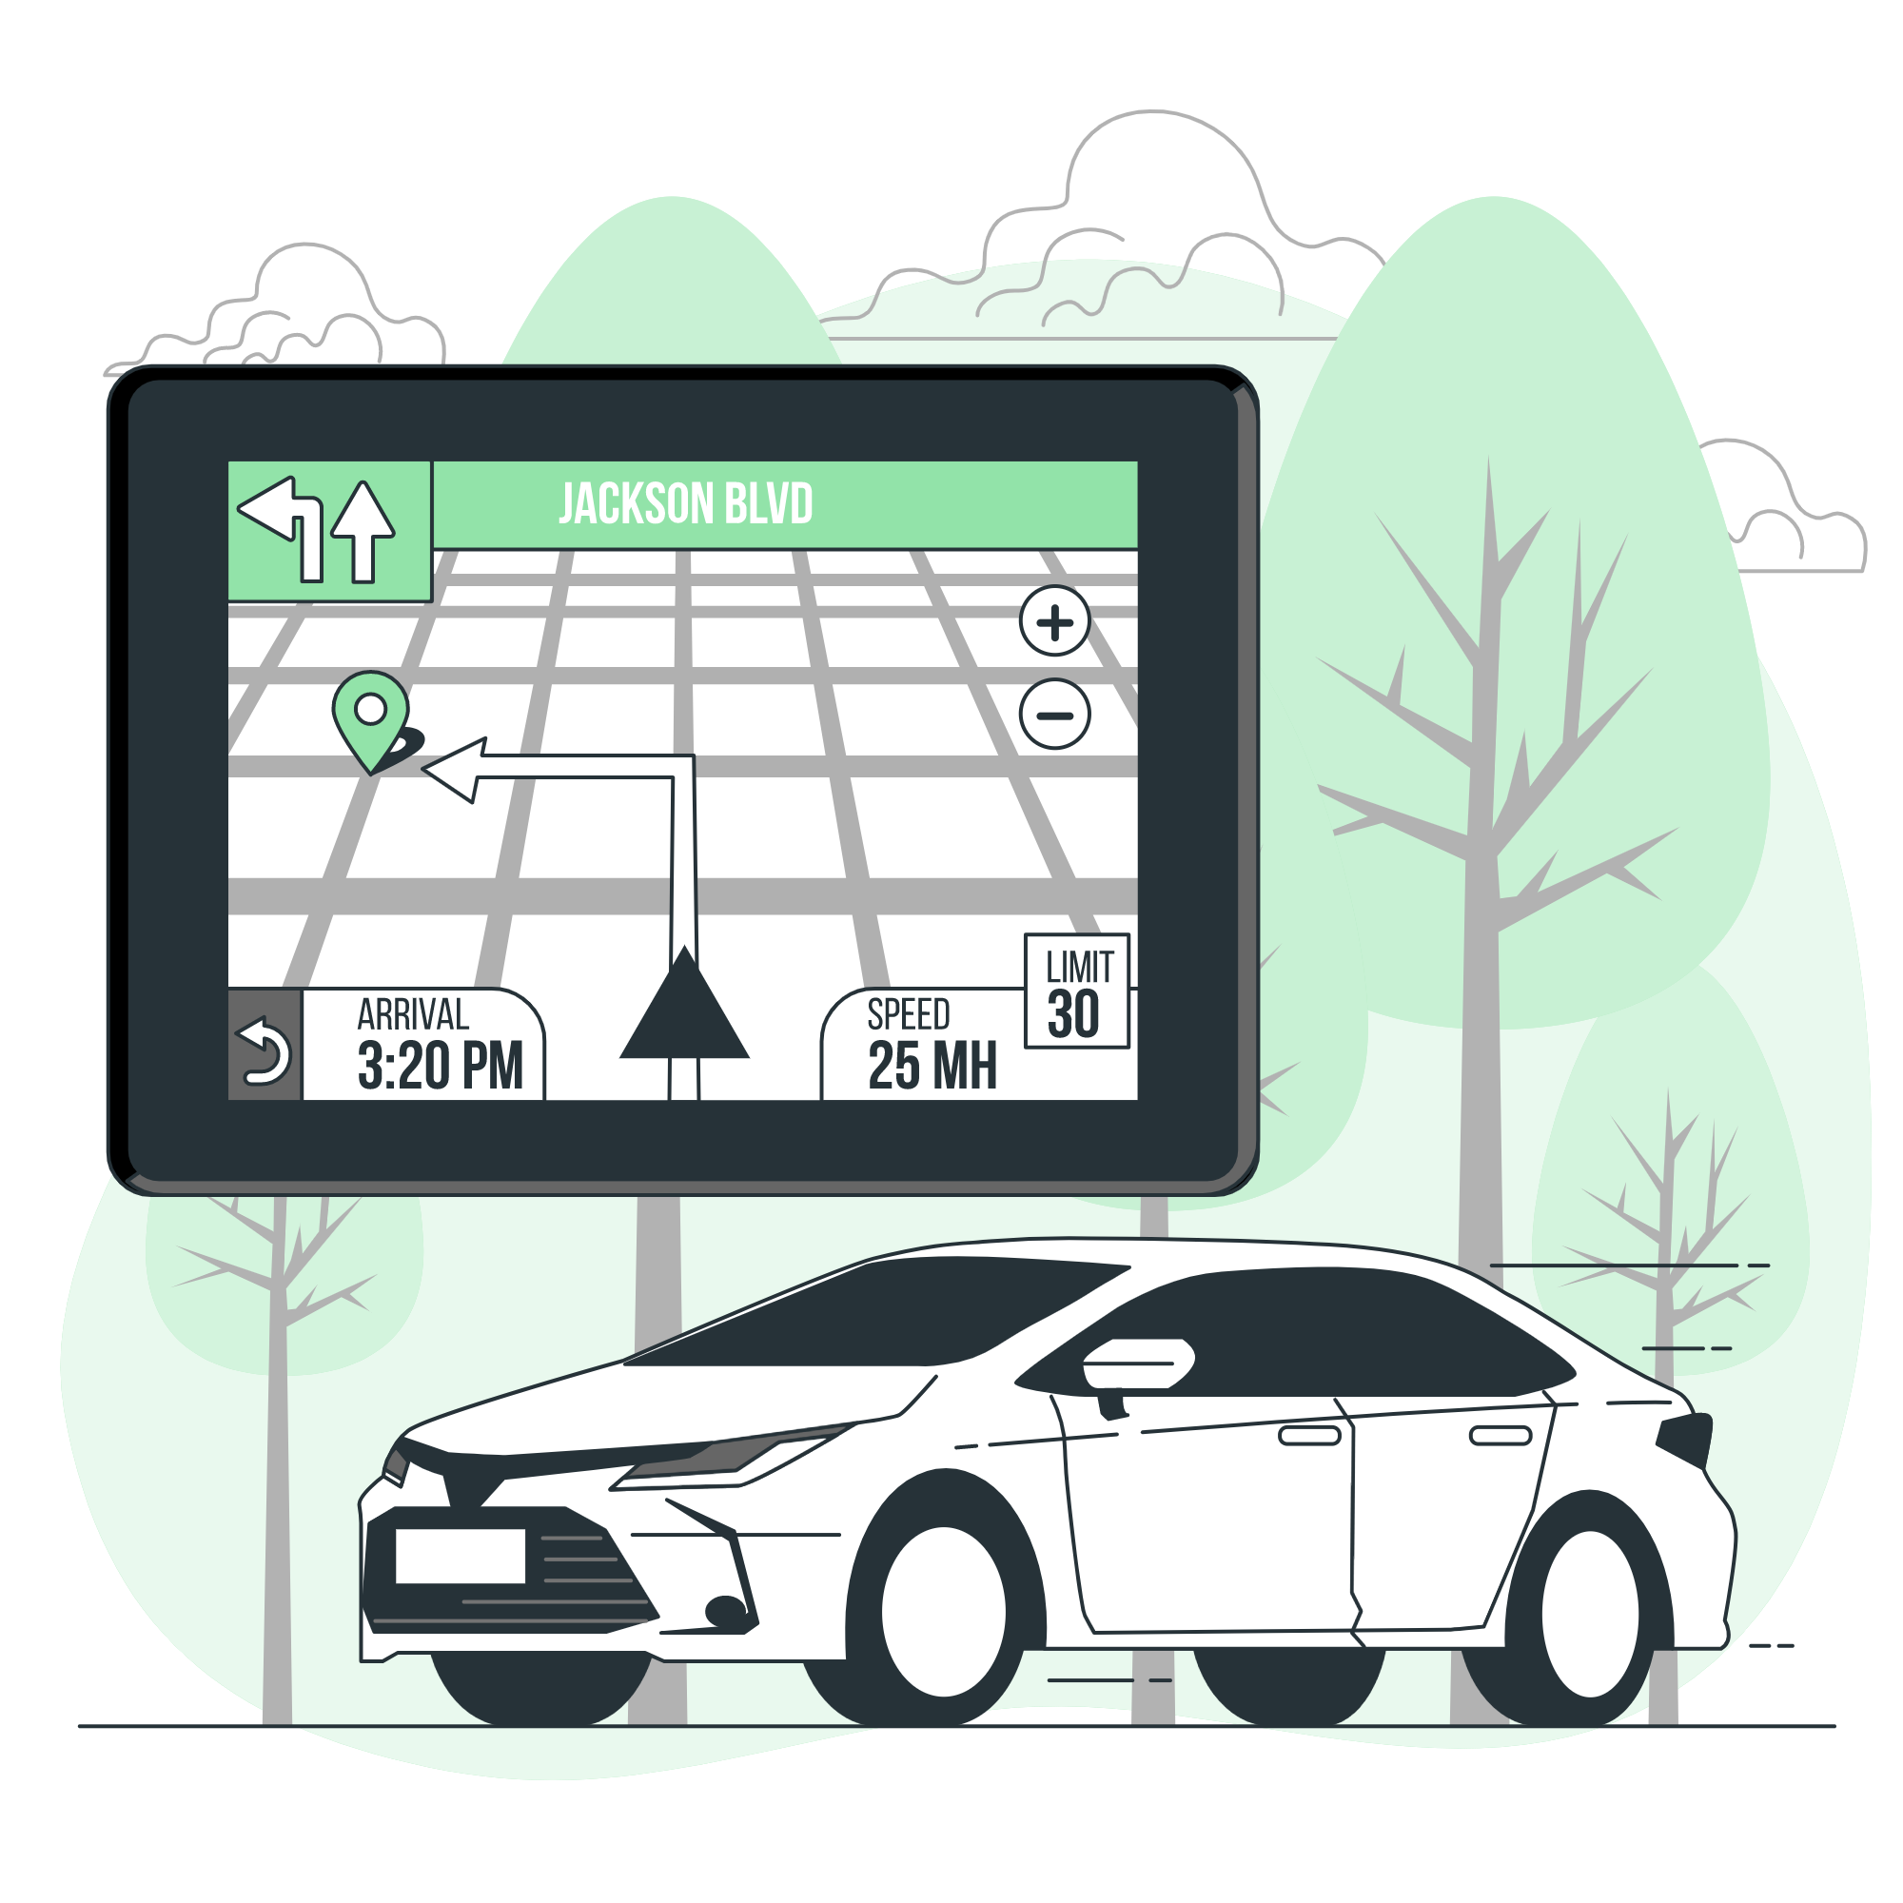
Self driving Car

Slide 16
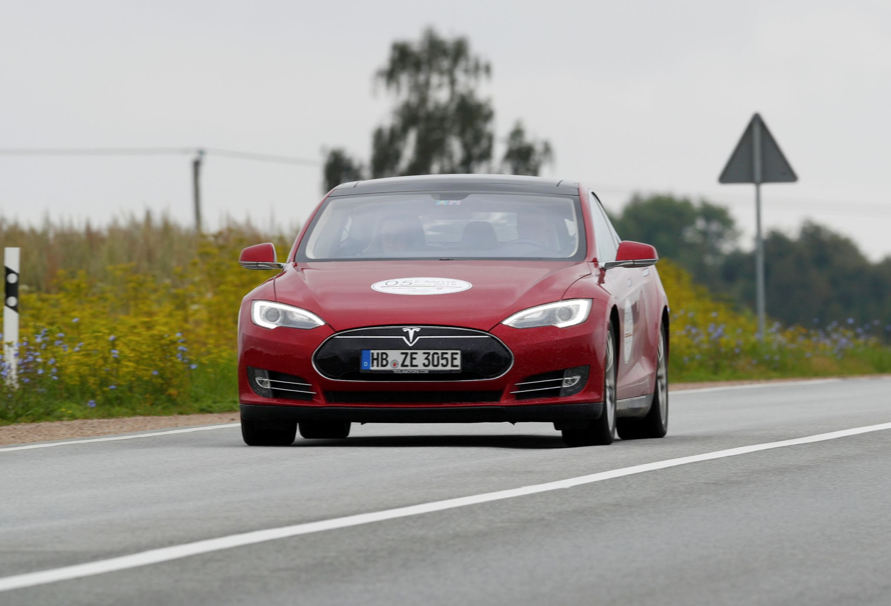
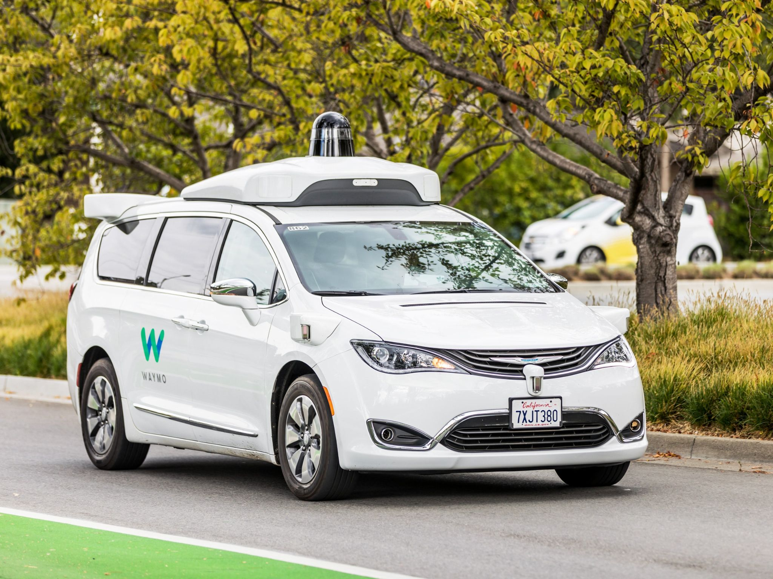
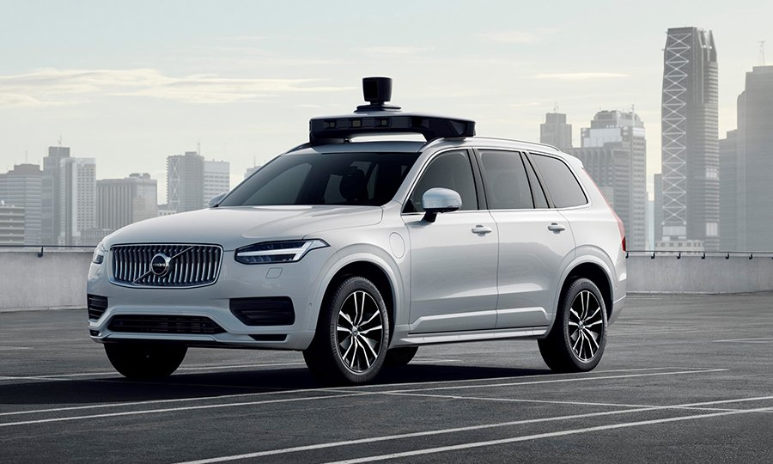
Self Driving Car
Tesla
Waymo
Uber-Volvo

Slide 17
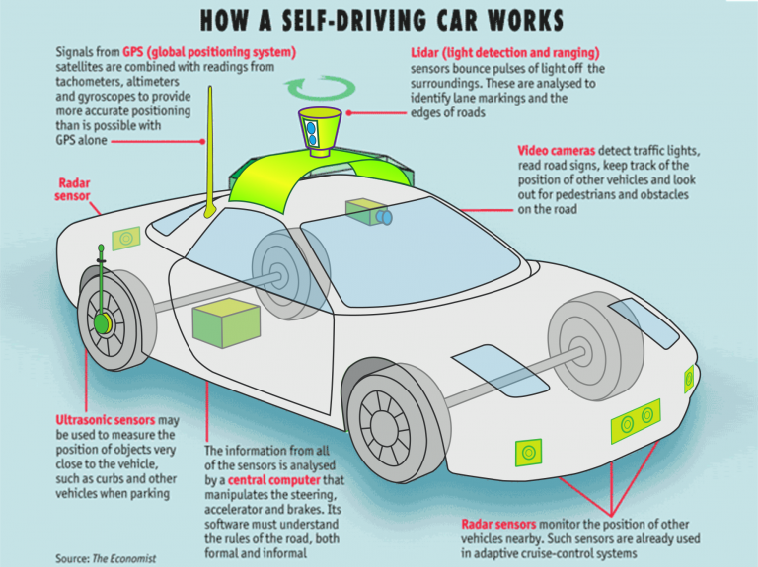

Slide 18

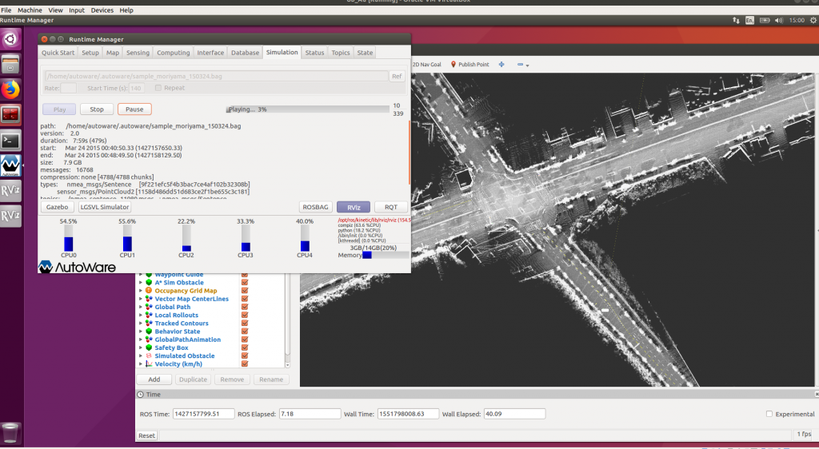
Autoware is the world's first "all-in-one" open-source software for self-driving vehicles. The capabilities of Autoware are primarily well-suited for urban cities, but highways, freeways, mesomountaineous regions, and geofenced areas can be also covered. The code base of Autoware is protected by the Apache 2 License

Slide 19
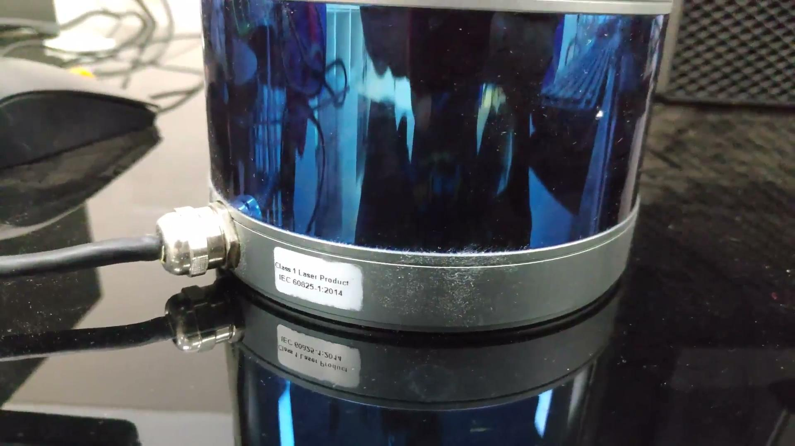
Lidar:RS16

Slide 20
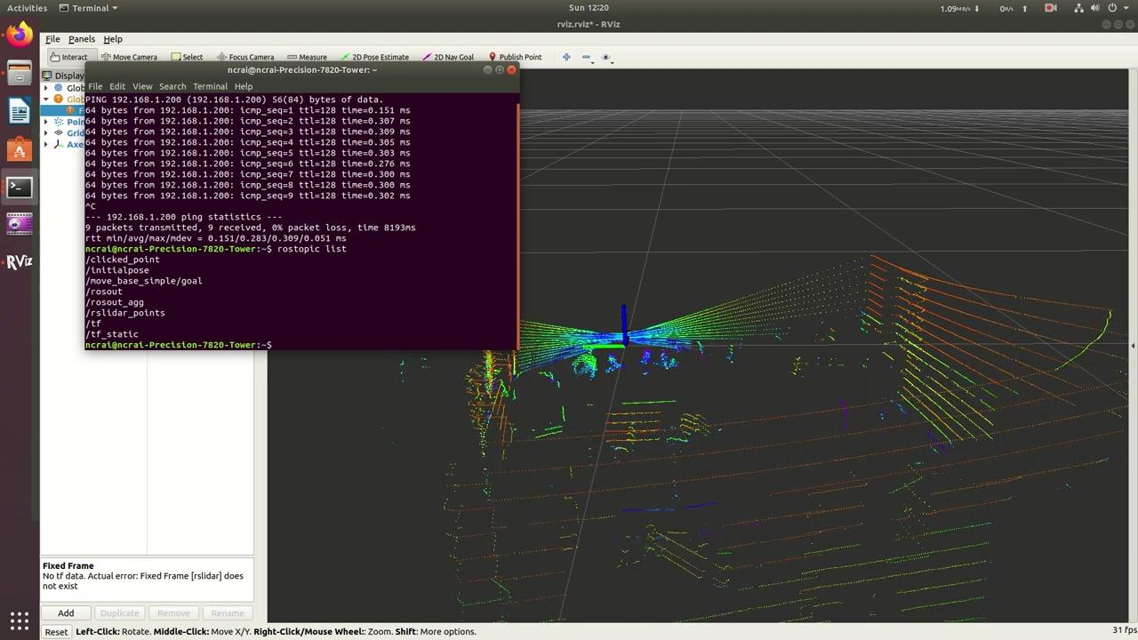
Live lidar data

Slide 21
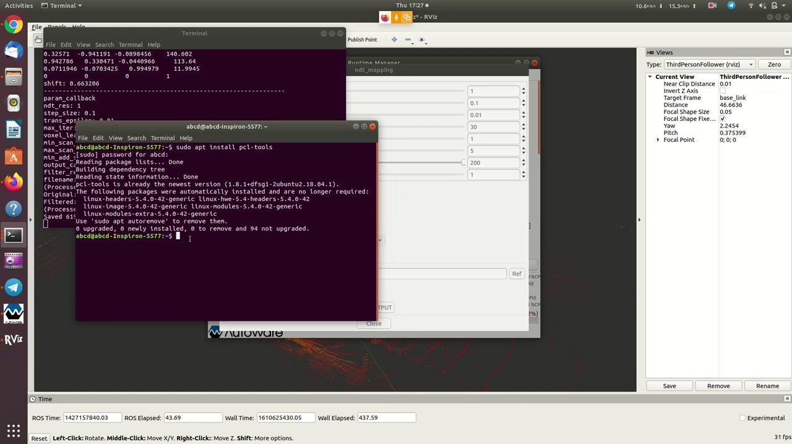
NDT mapping

Slide 22
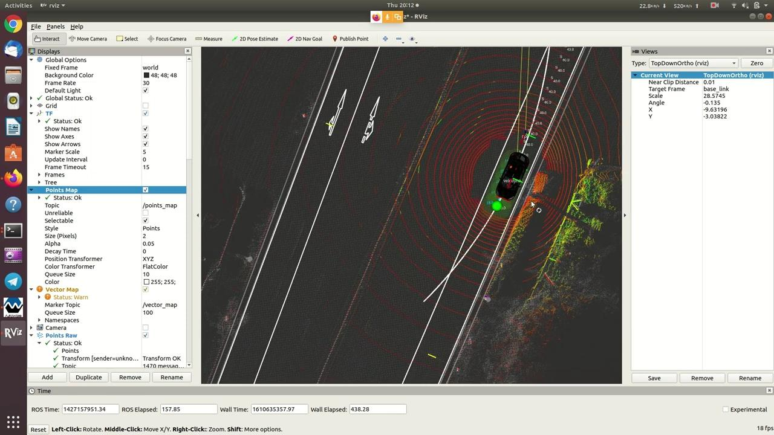
Path planning

Slide 23
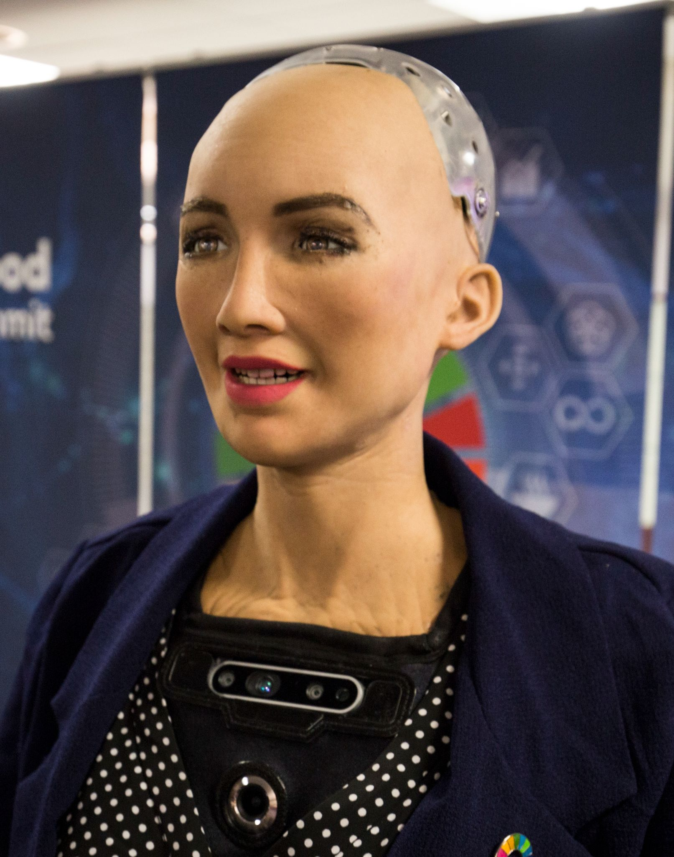
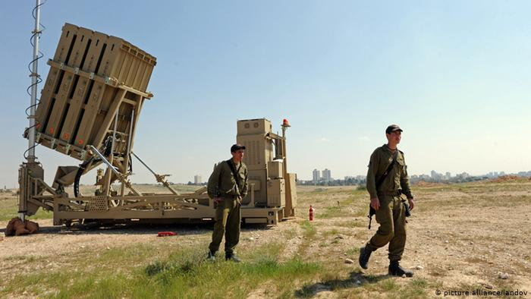
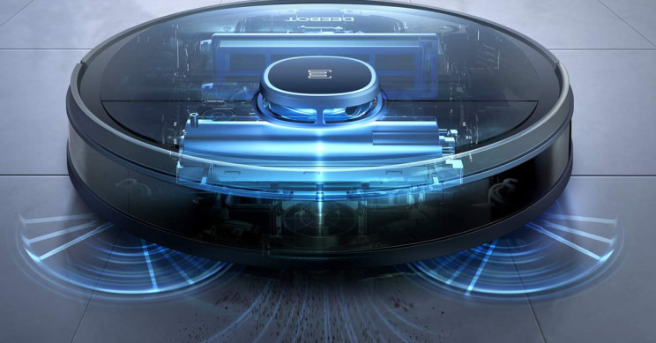

Slide 24
Basics that will help you
35%
Linux and Computer networks
65%
Programming Knowledge
(C++/Python)
85%
ML concepts
30%
Electronics/
Electrical/ Mechanical/CS
basics

Slide 25
How will I learn all that ?

Slide 26
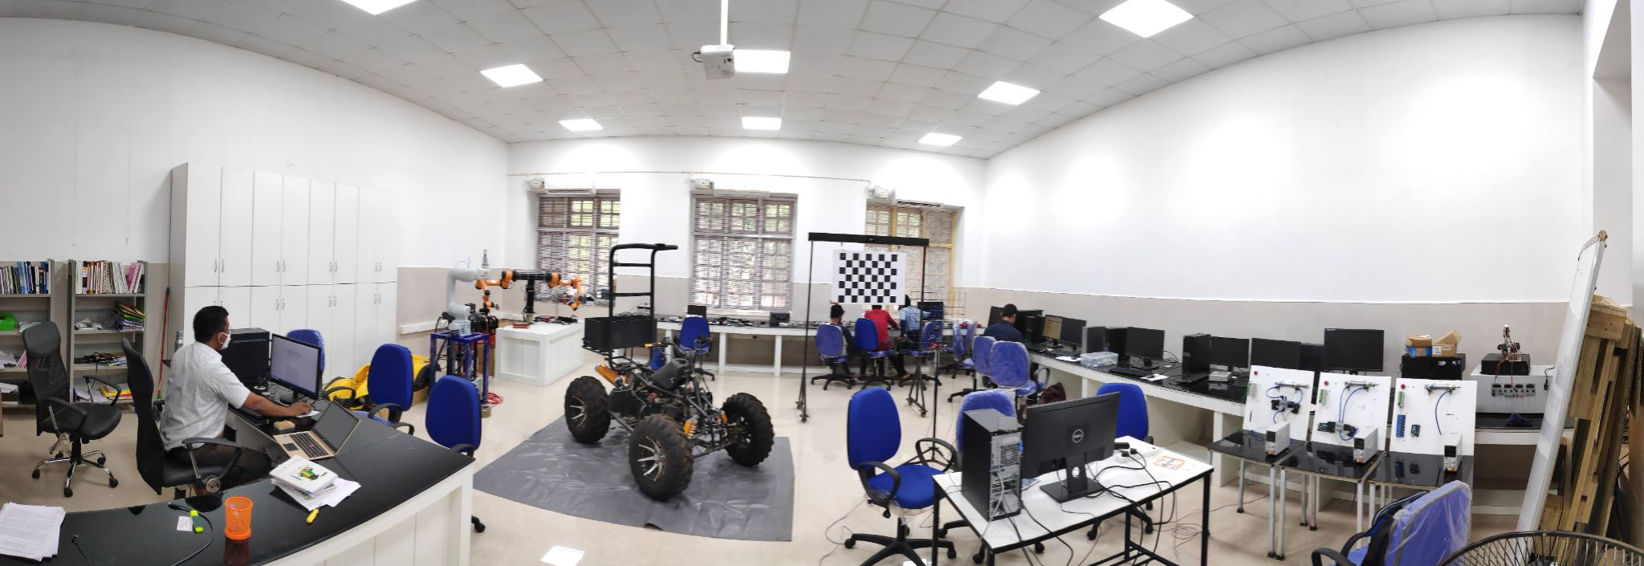
Nodal Centre for Robotics and AI
https://github.com/Nodal-Centre-for-Robotics-and-AI-GECT

Slide 27
Resources
C++/Python
W3school
Javatpoint
Tutorialspoint
Cpp
Linux
Cisco
bash
Electronics
Engineering Mindset
Paul McWhorter
Michel Van Biezen
How2electronics
Instructables
HowToMechatronics
ML
Sentdex
3blue1brown
Krish Naik
Daniel Bourke
Linear Algebra
Machine learning by Stanford University
ML
ROS
ROS Wiki
ROS in 5 days
ROS
ROS answers

Slide 28
Thanks!
Do you have any questions?
AASHIK M S
aashik1998.github.io
+91 974 498 0508
.
.
.
.
Please keep this slide for attribution

Slide 29
Table of Contents
1
4
2
5
3
Introduction
Some more Projects
Robotic Arm(manipulator)
Where to start?
Self driving Car

